Slide 1
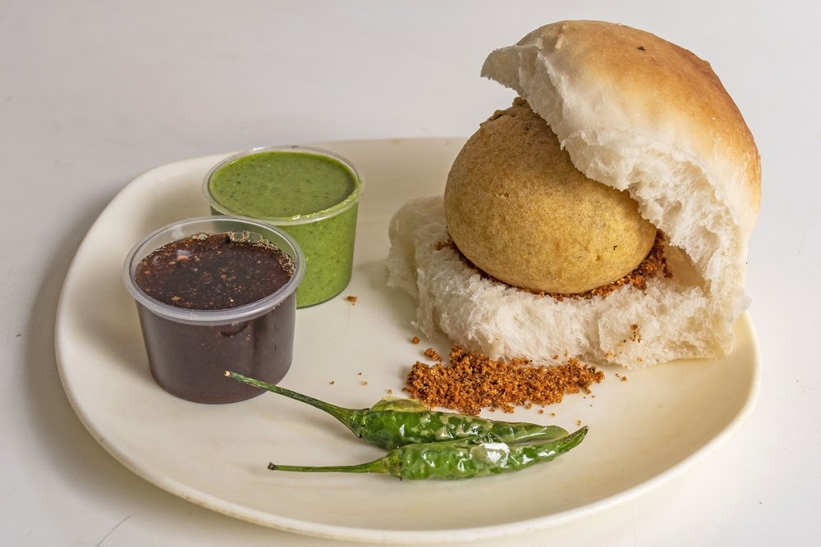

Slide 2
A man wants to open a Wada Pav Shop near Shivaji Nagar in Pune. He has got a location where there are other 4 more Wada pav shops. He is not able to understand what will be the strategy to take over his clients.
a. What will be the price of each Wada Pav?
b. How will he differentiate from the other competitors?
c. How will you bring insights when he has no data of his shop?
d. Why will be the Customer comes to your shop? (What will be the positioning)
How will you come to a solutions which will make him an entrepreneur and will help him to grow?

Slide 3
Agenda
Introduction
Problem statement and data source
Objectives and methodology
Solution with description
Impact

Slide 4
Introduction
In 1966 ,First Wada pav stall was started by Ashok Vaidya at Dadar Railway station in Mumbai
It is one of the favorite fast food for Mumbai kar or Maharashtrian people than any other fast food like Egg omelet, idali, Chinese etc.
It is also called as “Indian Burger”
As per Maharashtrian culture, one of the person who wants to start Wada pav Shop at Shivaji-nagar in Pune location situated in Maharashtra state.
But while starting the stall he comes to know that there are already four to five shops present at that location .
Now he wants to bring some strategy or implements some unique features in his business so that he will overcome the difficulties to maintain his shop.

Slide 5
Problem statement and data source
By understanding potential customers and trends of customers, one can invent some unique selling features in his/her business of Wada pav stall so that customers will auto-maticaly turns out towards his/her shop than others.
Data Source:
By conduction of Offline survey and Research from online food platform.

Slide 6
Objectives
To analyze whether Selected region is suitable for Wada pav shop
To conduct offline survey in that area
To do research on online food platform about that area.
To understand trend of people in region
To understand lifestyle of people living in that area
To understand what will be unique feature that have to implement
To finalize price of each Wada pav after conduction of survey in that area

Slide 7
Methodology
Need to conduct survey in Shivaji-Nagar area about potential customers.
To finalize location, where there will be less problem of parking.
Need to find out the trend of customers in chosen area.
Required to test the Wada pav of different stalls which are already present in that area
To invent some unique selling point which is different from others like Wada pav with tea.
Required to finalize price of Wada pav.

Slide 8
Descriptive Solution
First of all comes out with insights that, what is trend of customers, what are requirements of customers in the Shivaji nagar area.
Test the Wada pav of other food stall and make changes accordingly in your food item.
Then finalize the location for stall so that there may less chances of problems occurred due to Parking, and traffic etc.
Find out the scope of online platform like swiggy, Zomato etc. in that area.
Finalize the price of each Wada pav and try to give some USP.
Build the repo with visited customers to retain them for longer period

Slide 9
Impact
He will understand requirements and trends of customers in chosen area.
He will try to give extra (USP)along with Wada pav like saus or pudina chutney etc.
He will build repo with customers to retain them for longer time
By the time pass, he will understood do’s and don'ts in his business

Slide 10
THANK YOU

